Slide 1
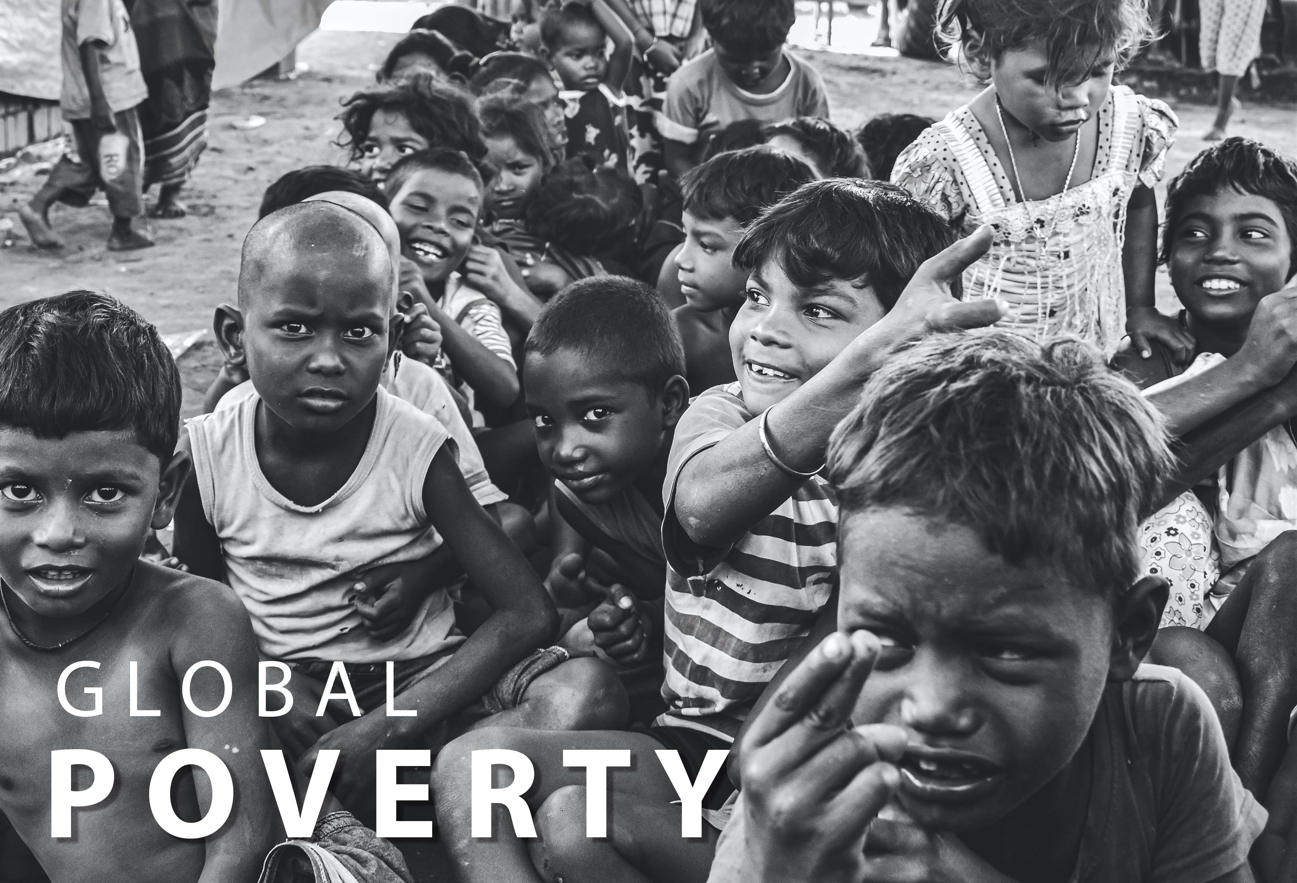

Poverty at Global Scale
Harshilkumar Kachhadiya
CWID : 20009344
M.S in Computer Science
ELC081A – Virginia Palau

Slide 2
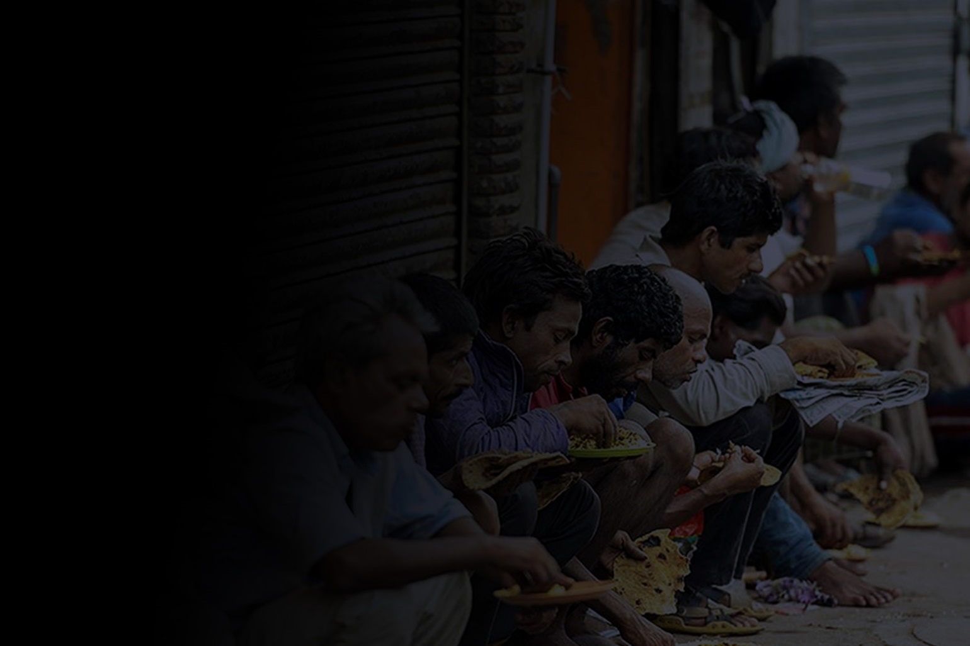
What is poverty at Global scale?
A person surviving on less than $1.90 a day lives in extreme poverty, as defined by the World Bank.
More than 736 million people or one out of every ten people on the planet currently live below this poverty threshold, and children, a highly vulnerable segment of society, account for more than half of the world’s poorest citizens.

Slide 3
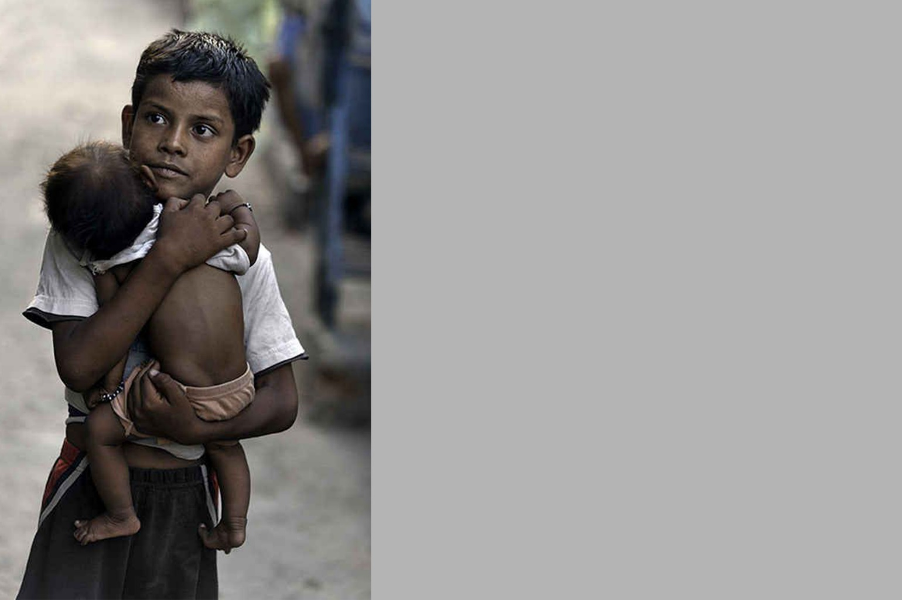
Agenda
Type of poverty
The scale of Poverty around the world
What Is the main solution to decrease the poverty level

Slide 4
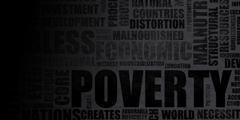
Type of the poverty
Lack of Income & Resources to Ensure Sustainable Livelihoods
Hunger and Malnutrition
Health
Limited or Lack of Access to Education
Homelessness & Inadequate Housing

Slide 5

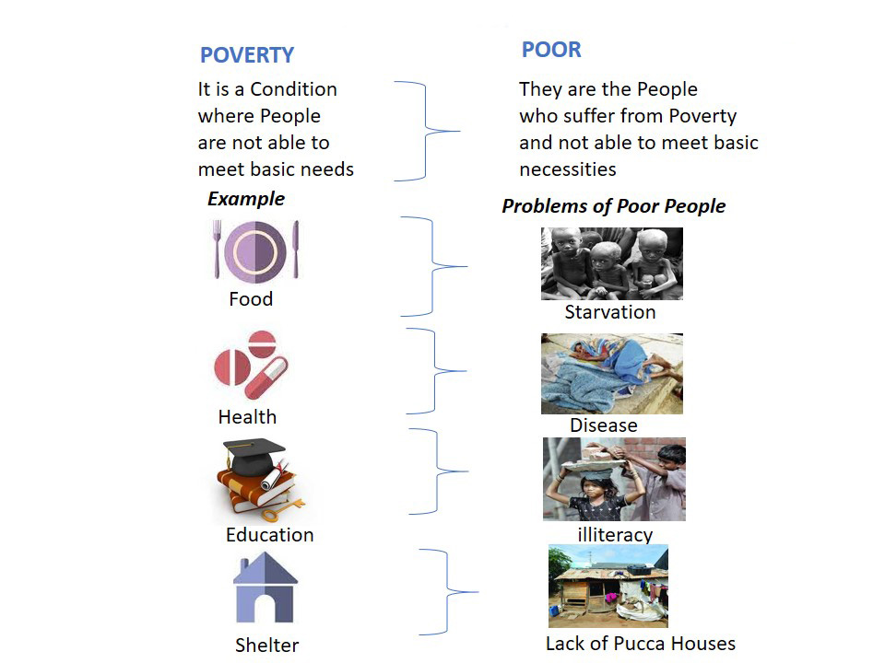
Who
Are
The
Poor ?

Slide 6

Poverty around the world
Extreme poverty is measured as the number of people living on less than $1.90 per day.
2018 is the last year with official global poverty estimates. 'No pandemic projection' utilizes Global Economic Prospects growth forecasts from before the COVID-19 pandemic.
Baseline and pessimistic projections utilize growth forecasts from April 2022 Poverty Outlooks. Baseline scenario distributes the impacts of the COVID-19 pandemic, rising inflation, and the conflict in Ukraine equally to all households.

Slide 7
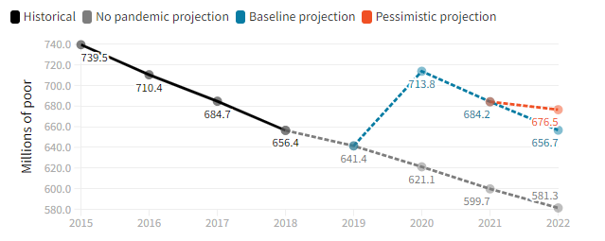

Slide 8
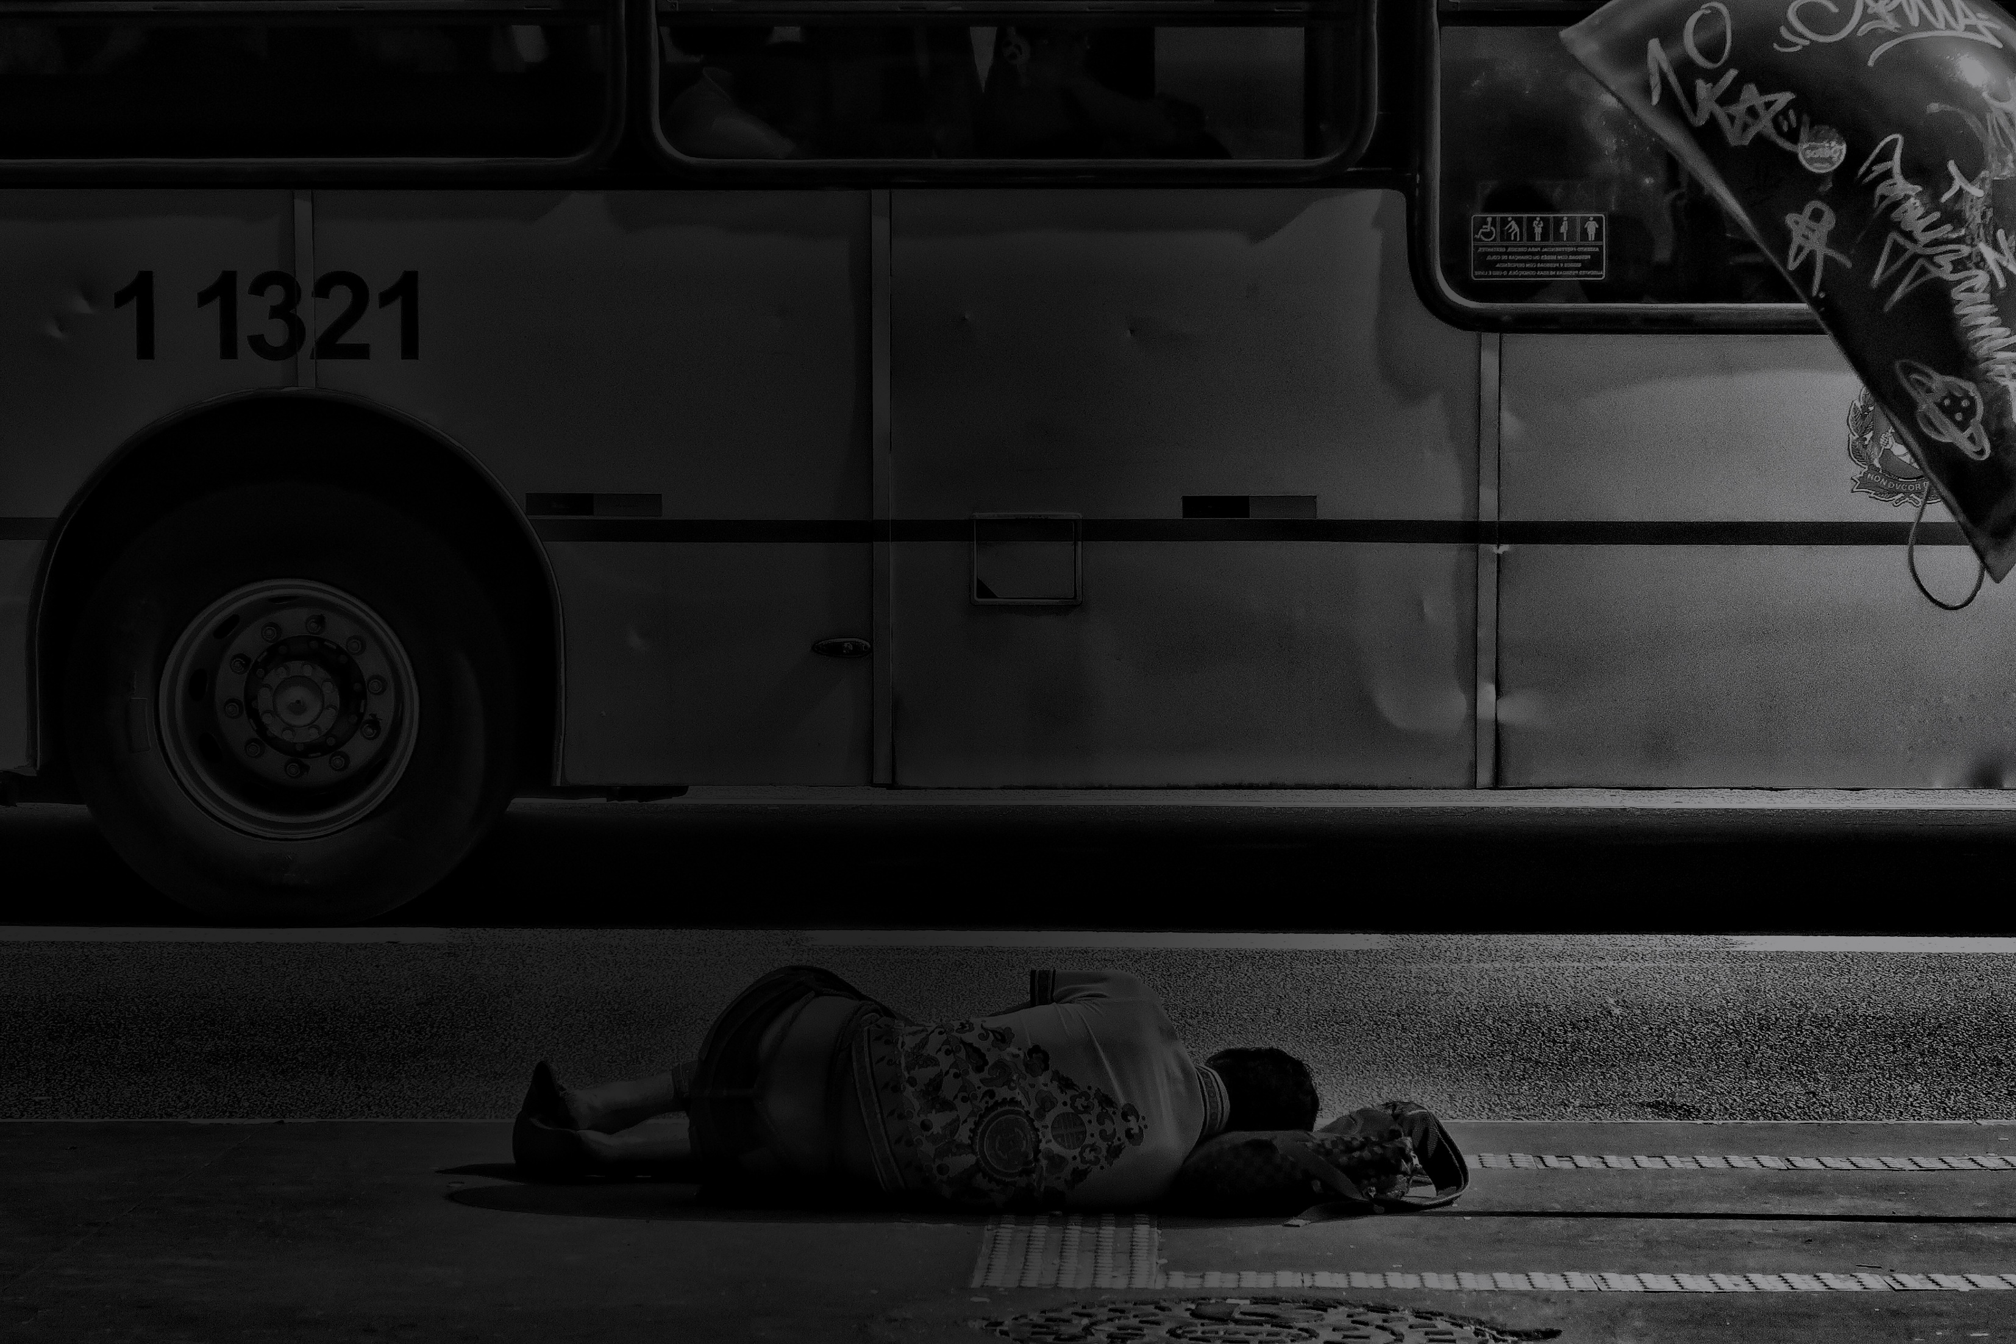
Possible Solution
Educate children
Raise the minimum wage
Provide clean water
Ensure basic health care
Create jobs

Slide 9
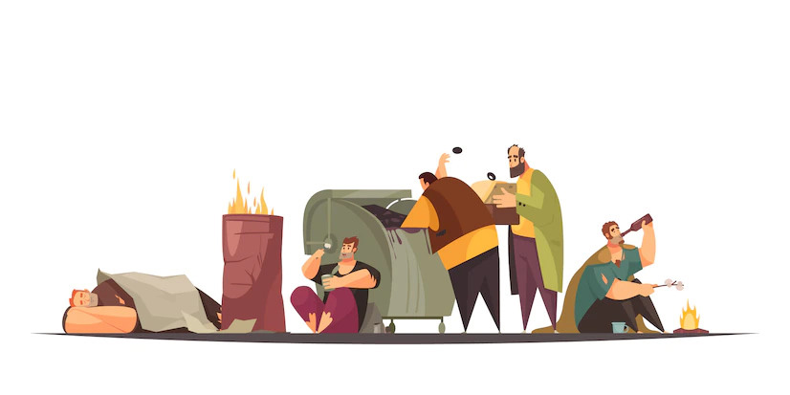
summery
Poverty is serious issue in our world.
Though many organizations have been created to find solutions for this matter nobody could not save our world completely from poverty.
The most common fact which we can realize when we consider on information about poverty is that poverty is mostly occurring in developing countries.

Slide 10
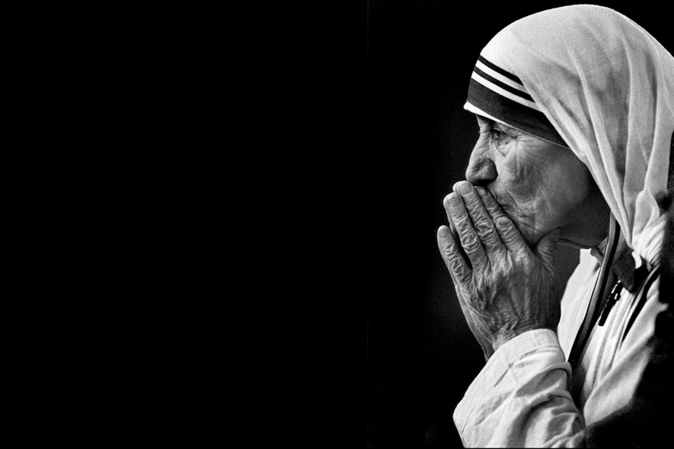
Thank you
“If you can’t feed
a hundred people
then feed just one“
Mother Teresa, 1910

